Slide 1
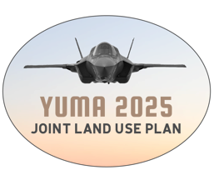
Public work session #2
AUGUST 22, 2024

Slide 3
project update

Slide 4
Civilian-side & Military Impacts

Slide 5
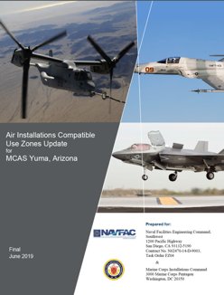
Prior State & Local efforts
1990 State Statutes requiring local compatibility planning
1996 City of Yuma Joint Land Use Plan
2004 City adopts Rural Density land use designation around BMGR
2005 City of Yuma & Yuma County
- JLUP Strategies Review
- Joint Land Use Study (Gila Bend AF Aux Field, BMGR)
2019 Air Installations Compatible Use Zones Report released
2024 Joint Land Use Plan 2025 Update Begins

Slide 6
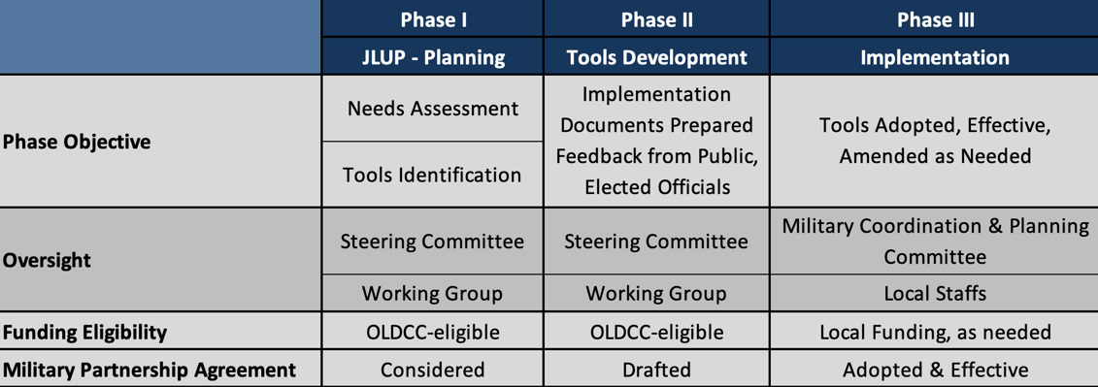
The big picture

Slide 7
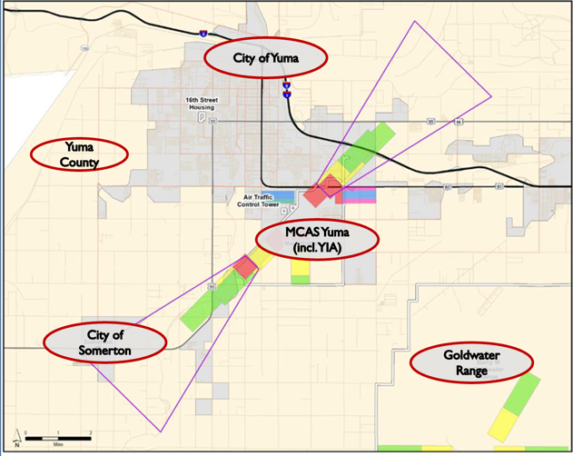
Participating entities
Local Governments and
MCAS Yuma

Slide 8
Participating entities
Working Group
Provides technical input and support to the Consultant Team and Steering Committee
Steering Committee
Guides the JLUP Process and Develops Policy Recommendations and the Final Report
Local staffs and base officials, as well as community group and industry representatives
Elected and Management-level Representatives of local government and the base

Slide 9
Participating entities
Property Owners, Businesses,
members of the Public
Providing input and feedback to the committees and Consultant Team throughout the project.

Slide 10
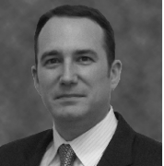
Consultant TEAM
Land use Planners, Attorneys, GIS specialists, Environment and Compatibility
Project Management, Public Outreach
Recommendations and Support to the JLUP Steering Committee

Slide 11
JLUP Project Phasing
May - August
Information and Baseline Conditions
Land Planning and Operational Analysis (mapping & policy)
June - Oct
Public Outreach / Input
Nov - Feb ‘25
Consideration of Policy Alternatives
Steering Committee Recommendations
Final JLUP Update Report
March - May

Slide 12
JLUP Project Phasing
May - August
Information and Baseline Conditions
Land Planning and Operational Analysis (mapping & policy)
June - Oct
Public Outreach / Input
Nov - Feb ‘25
Consideration of Policy Alternatives
Steering Committee Recommendations
Final JLUP Update Report
March - May

Slide 13
STEPS So Far
Community and Installation Tours
Public Kick-Off #1
Agency Stakeholder Sessions
Agency Fact-Finding Exercise
Ongoing Steering Committee/Working Group Meetings
Initial Compatibility Analyses Underway
Community Questionnaire Opened (Aug 22nd)

Slide 14
JLUP Project Phasing
May - August
Information and Baseline Conditions
Land Planning and Operational Analysis (mapping & policy)
June - Oct
Public Outreach / Input
Nov - Feb ‘25
Consideration of Policy Alternatives
Steering Committee Recommendations
Final JLUP Update Report
March - May

Slide 15
JLUP Project Phasing
May - August
Information and Baseline Conditions
Land Planning and Operational Analysis (mapping & policy)
June - Oct
Public Outreach / Input
Nov - Feb ‘25
Consideration of Policy Alternatives
Steering Committee Recommendations
Final JLUP Update Report
March - May

Slide 16
Project website Update

Slide 17
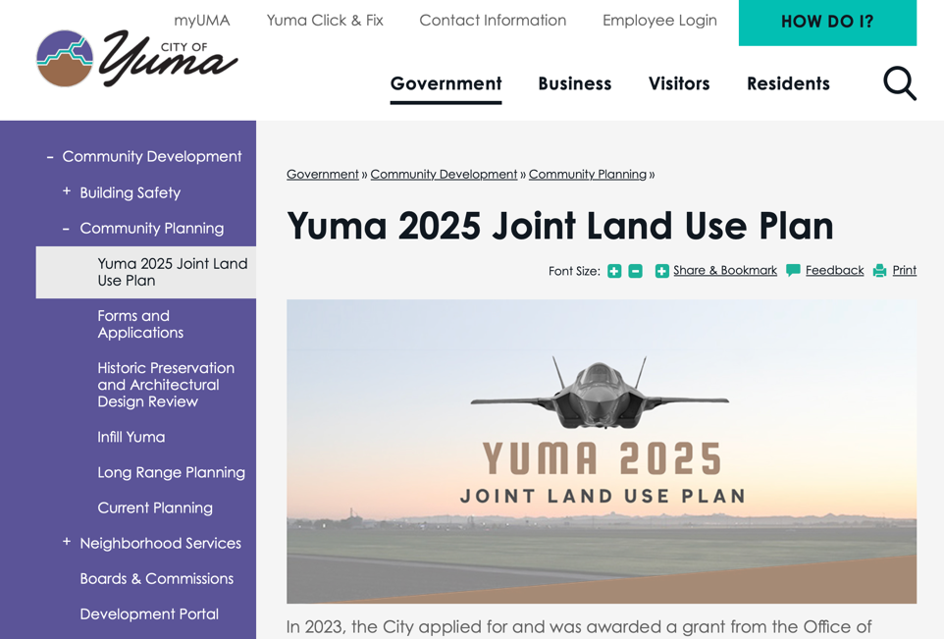

Slide 18
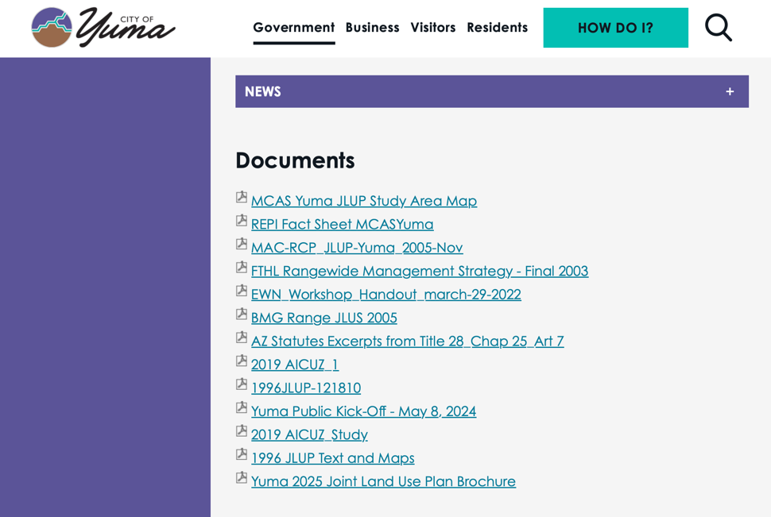

Slide 19
study area / Focus area map

Slide 20
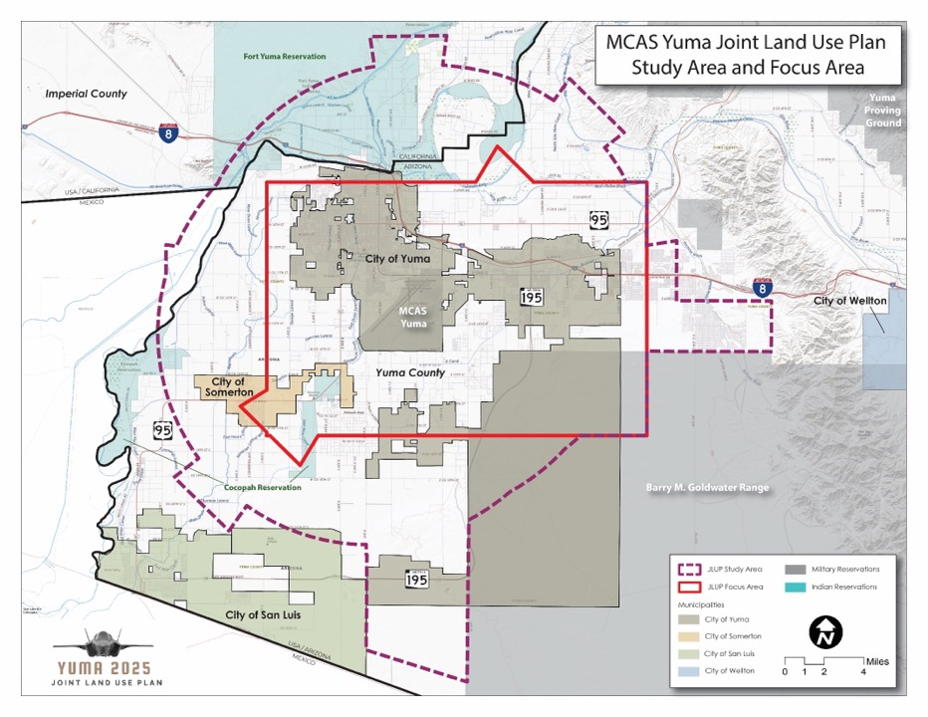
Study Area Map

Slide 21
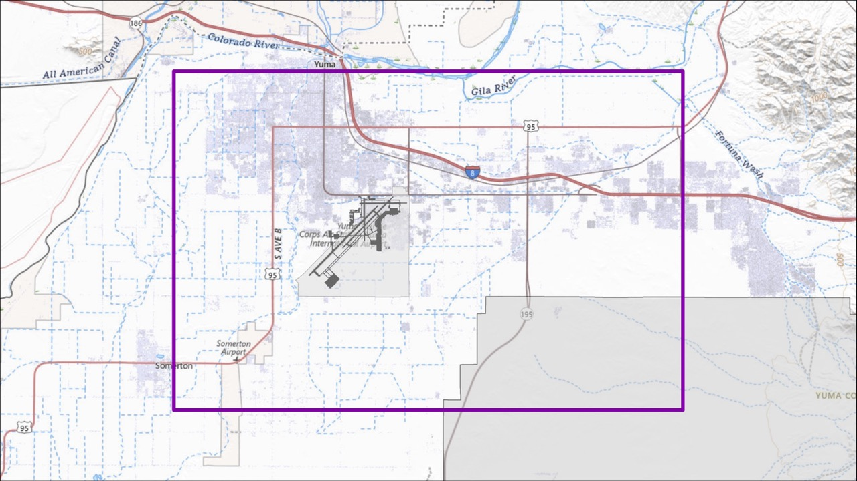
ARS 28-8461 Territory in the Vicinity of MCAS Yuma
MCAS Yuma
Barry M. Goldwater Range

Slide 22
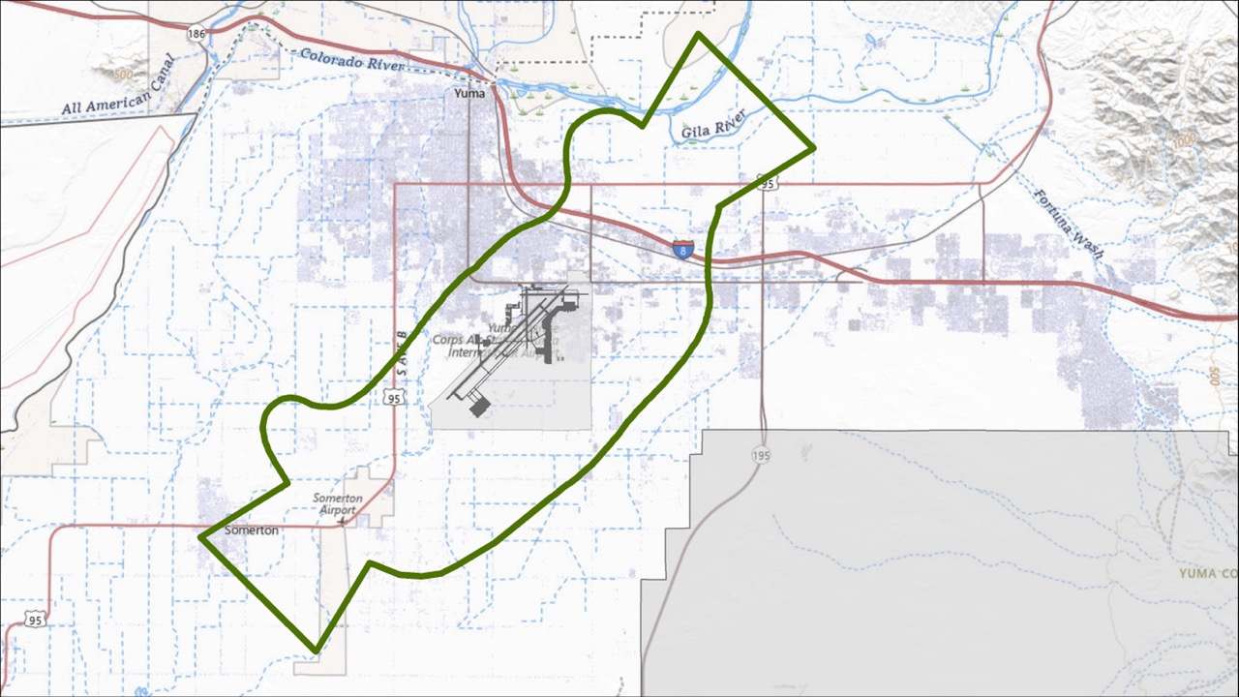
ARS 28-8461 High Noise or Accident Potential Zone
MCAS Yuma
Barry M. Goldwater Range

Slide 23
preliminary compatibility maps and analysis

Slide 24
Compatibility Analysis
Assess the compatibility of existing land use and development patterns, zoning regulations, and adopted future land use plans with regard to:
Aircraft Accident Potential Zones (APZ)
Aviation Noise
Hazards to safe aerial navigation
Other documented military training & operational impacts

Slide 25
Compatibility Analysis
Analysis is performed in accordance with guidance for compatible land use as set forth in DoD Instruction 4165.57 and Marine Corps Order 11010.16A (Air Installation Compatible Use Zones)
AICUZ compatibility guidance classifies land uses in four categories based on the type and degree of impact:
Compatible
Compatible with Restrictions (such as maximum size / floor area ratio)
Incompatible
Incompatible with Exceptions (such as local community needs)

Slide 26
Compatibility Analysis
The guidance established in DoD Instruction 4165.57 and Marine Corps Order 11010.16A is different in some ways than what is enacted in statute in ARS 28-8481 and implemented at the local level under the statutory mandate.

Slide 27
Compatibility Analysis
Examples of where State and DoD guidance diverges:
ARS 28-8481 requires permitting single family residential uses on property used for agricultural purposes in 65+ dB noise zones.
ARS 28-8481 prohibits all eating and drinking places in Accident Potential Zones

Slide 28
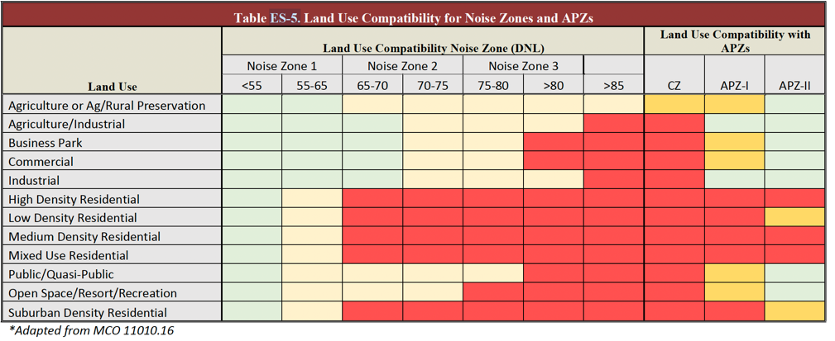

Slide 29
Compatibility Analysis
Data collection to support the compatibility analysis includes:
GIS parcel data with Yuma County Tax Assessor use codes for the classification of existing land uses in the Focus Area and determining land subdivision patterns / parcel sizes (for density).
Zoning data, maps, and ordinances for the City of Yuma, Yuma County, and City of Somerton.
Adopted general / comprehensive plans and future land use maps for each jurisdiction.

Slide 30
Compatibility Analysis
Compatibility Analysis Assumptions:
Yuma County Tax Assessor land use data is accurate
Current overlay zoning provides for compatible outcomes unless otherwise indicated by review.
When a point of divergence is found between compatibility guidance and zoning regulations, the entire district is affected.
There is no guarantee of permanent statutory protection, so future land plans are evaluated in that context.

Slide 31
Aircraft accident potential compatibility
The primary focus of the land use recommendations for Clear Zones and accident potential zones is SAFETY.
Within the Clear Zone, only open uses of land are recommended – like agriculture or public open space (not parks).
The range of recommended uses increase in APZ 1, with a wider range in APZ 2, but through the APZs, assembly uses and other uses that concentrate people or pose secondary hazards are not recommended.

Slide 32
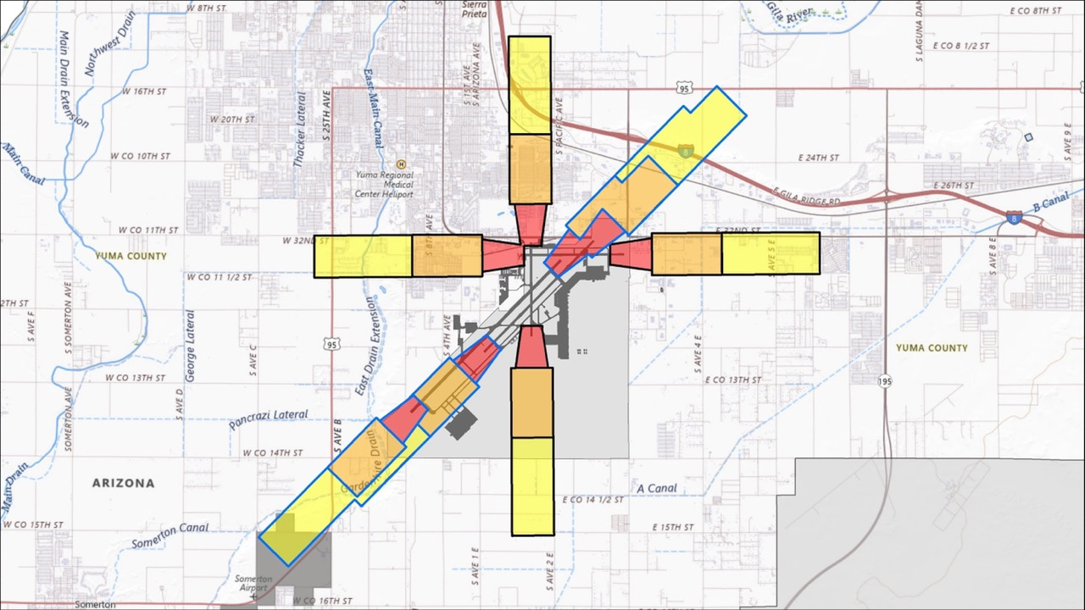
Accident Potential Zones
Accident Potential Zones
Clear Zone
APZ 1
APZ 2
APZ Regulatory Status
Currently Regulated
CZ
2019 AICUZ Additions
APZ 1
APZ 2
Barry M. Goldwater Range

Slide 33
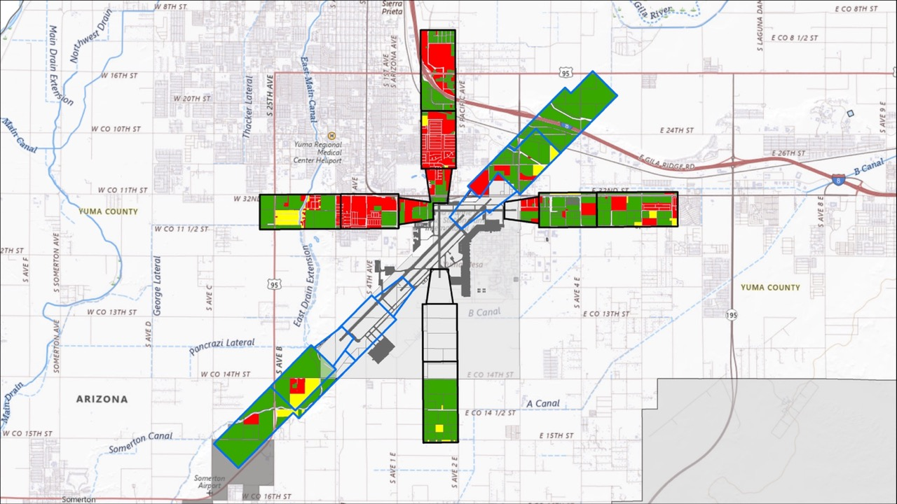
Accident Potential Zones
Existing Land Use Compatibility
Accident Potential Zones
Existing Land Use Compatibility
Currently Regulated
CZ
Compatible
2019 AICUZ Additions
Conditionally Conditional
APZ 1
Incompatible
APZ 2
Barry M. Goldwater Range

Slide 34
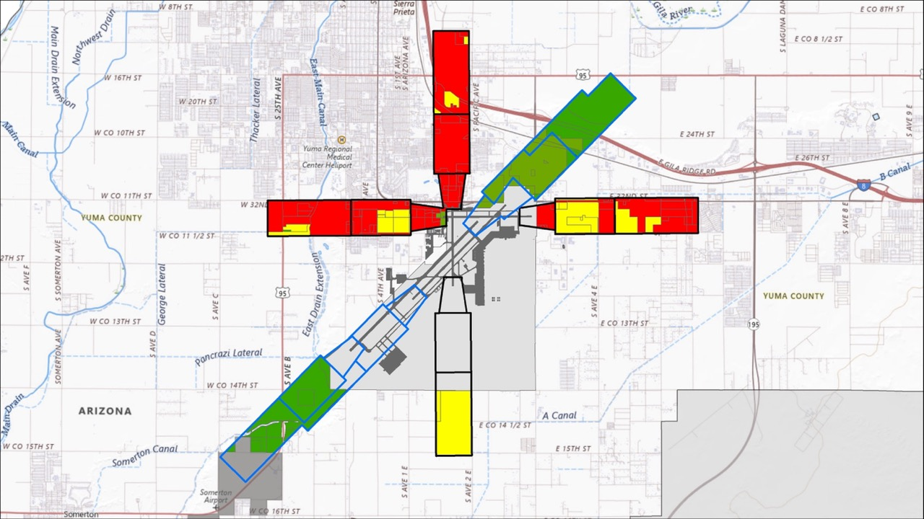
Accident Potential Zones
Zoning Compatibility
Accident Potential Zones
Zoning Compatibility
Currently Regulated
CZ
Compatible
2019 AICUZ Additions
Conditionally Conditional
APZ 1
Incompatible
APZ 2
Barry M. Goldwater Range

Slide 35
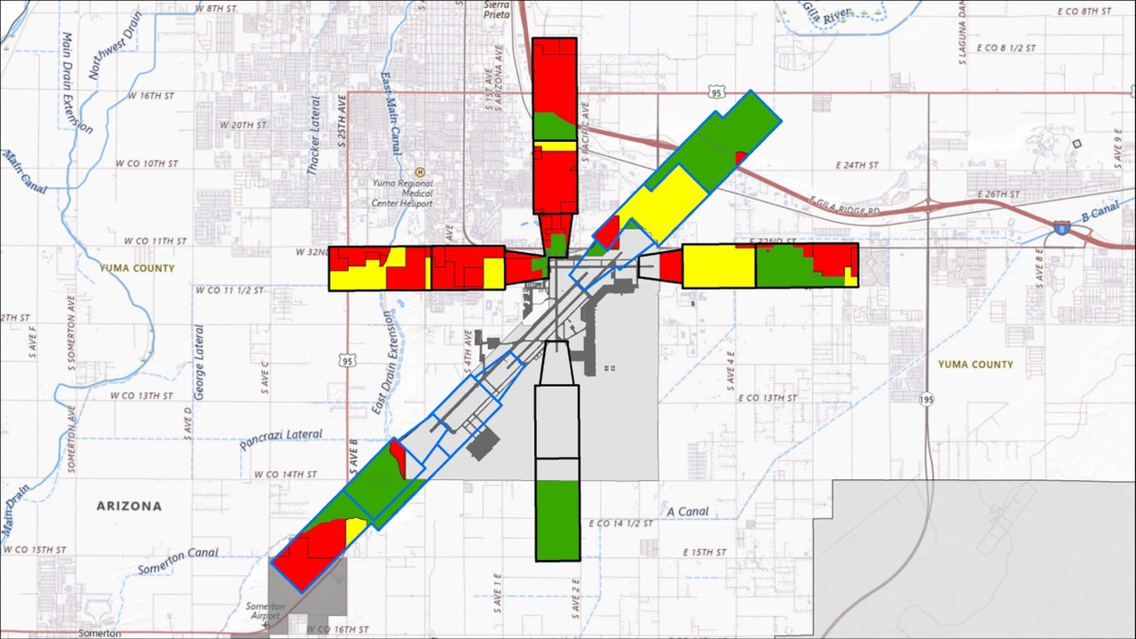
Accident Potential Zones
Future Land Use Compatibility
Accident Potential Zones
Future Land Use Compatibility
Currently Regulated
CZ
Compatible
2019 AICUZ Additions
Conditionally Conditional
APZ 1
Incompatible
APZ 2
Barry M. Goldwater Range

Slide 36
Aviation Noise compatibility
Recommended land uses in 65+ dB noise zones are intended to promote development patterns that generally exclude noise-sensitive uses (residences, schools, churches, hospitals, etc.).
Some land uses may be compatible if interior noise level reduction is provided to mitigate impacts.
Prior to 2015 AICUZ instructions included low-density single-family residential uses in 65-69 dB zones with mitigation.
Note – the analysis is performed for the pre-2019 noise zones.

Slide 37
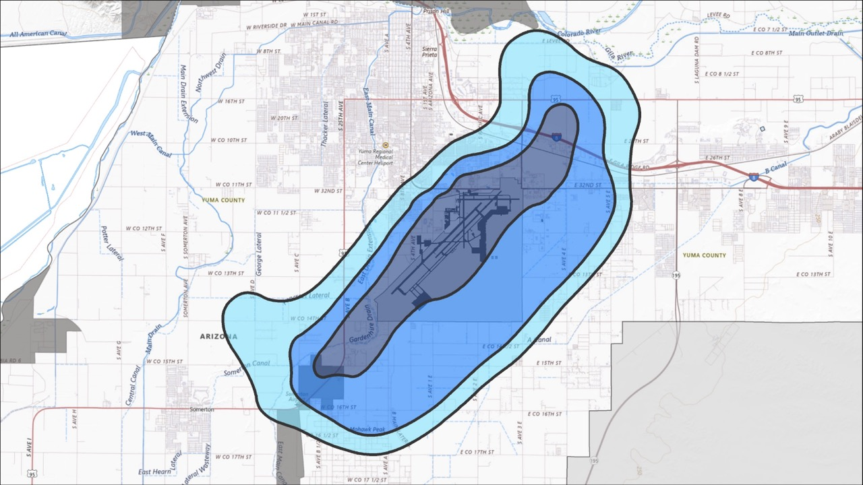
65+ dB Aviation Noise Zones
Noise Zones
65 – 69 dB
70 – 74 dB
75+ dB
70 dB
75 dB
MCAS Yuma
65 dB
Barry M. Goldwater Range

Slide 38
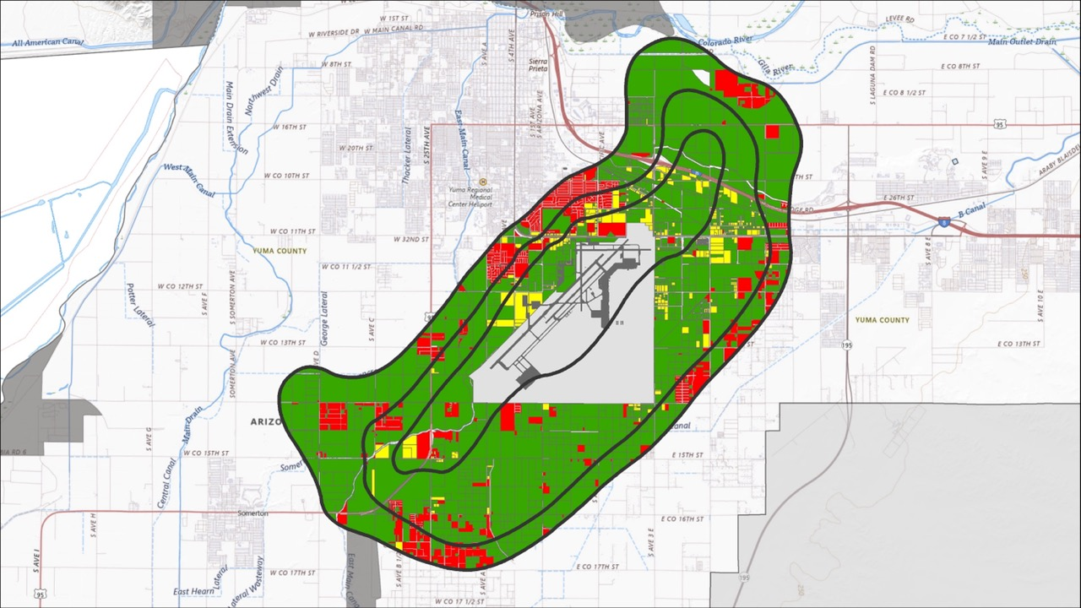
65+ dB Aviation Noise
Existing Land Use Compatibility
Existing Land Use Compatibility
Compatible
Conditionally Conditional
Incompatible
70 dB
75 dB
MCAS Yuma
65 dB
Barry M. Goldwater Range

Slide 39
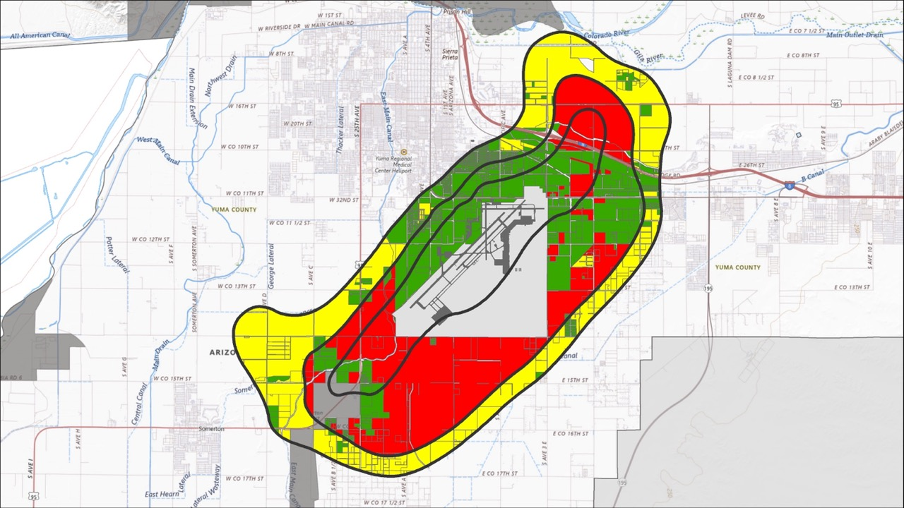
65+ dB Aviation Noise
Zoning Compatibility
Zoning Compatibility
Compatible
Conditionally Conditional
Incompatible
70 dB
75 dB
MCAS Yuma
65 dB
Barry M. Goldwater Range

Slide 40
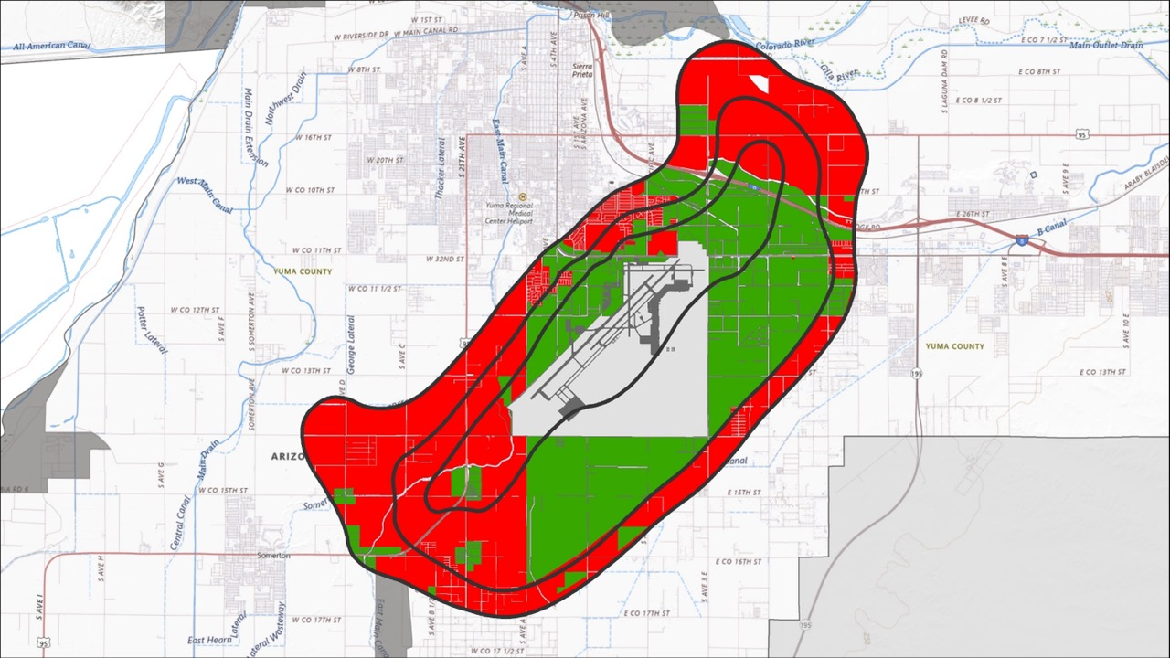
65+ dB Aviation Noise
Future Land Use Compatibility
Existing Land Use Compatibility
Compatible
Conditionally Conditional
Incompatible
70 dB
75 dB
MCAS Yuma
65 dB
Barry M. Goldwater Range

Slide 41
BMGR Range BufFer
Recommended land subdivision / residential density within one mile of the BMGR range is 1 dwelling unit / 2 acres.
Portions of the range boundary, including areas along the west side of the range south of 17th Street are recommended to have a maximum density of 1 dwelling unit / 5 acres.
Analysis compares existing parcel sizes to recommended residential development density.

Slide 42
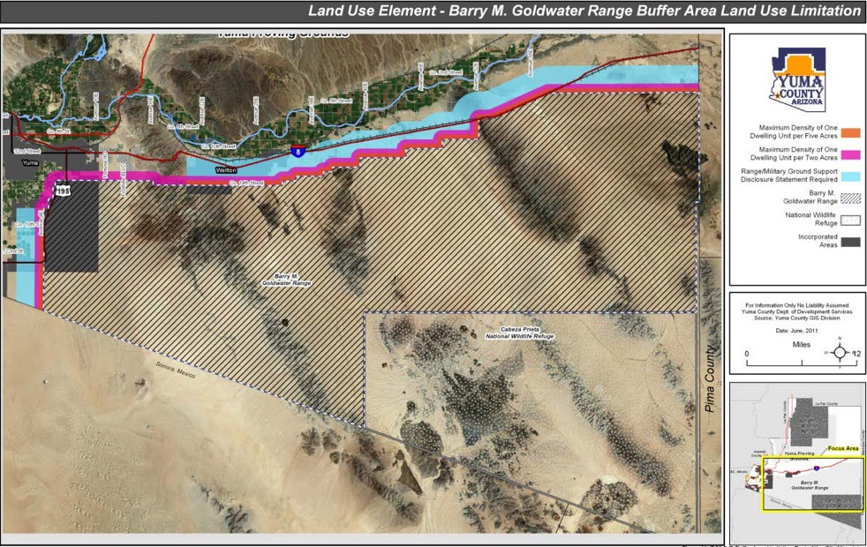
BMGR Recommended
Range Compatibility Buffer

Slide 43
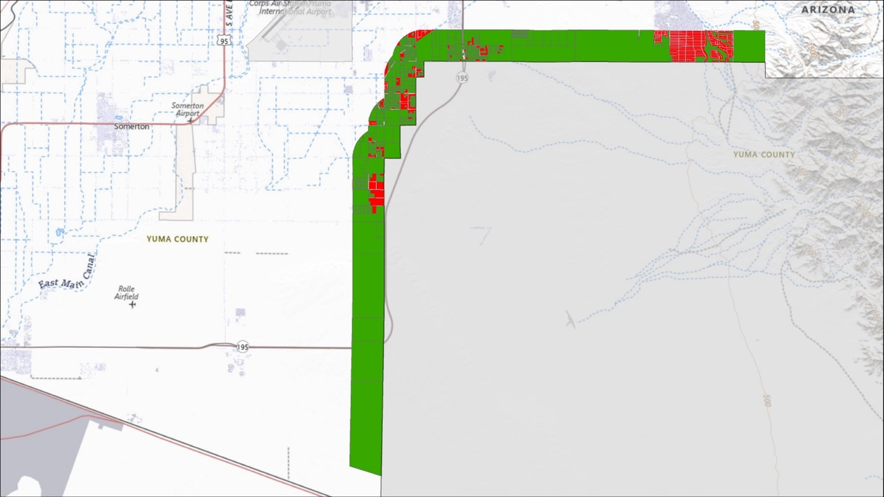
BMGR One Mile / Half Mile Buffer Parcel Size Alignment
Meets Minimum Acreage
Below Minimum Acreage
Recommended 2 Acre Minimum within 1 Mile
Recommended 5 Acre Minimum within ½ Mile
Barry M. Goldwater Range

Slide 44
Remotely piloted Aircraft (RPA) Operations
MQ-9A Reaper remotely piloted aircraft will operate between MCAS Yuma and the restricted airspace at BMGR (R-2301W).
Departure and arrival flight tracks are designed to transit to restricted airspace as quickly as possible.
Existing land use patterns along the approach and departure routes are generally commercial, industrial, agricultural, and rural density residential in nature.

Slide 45
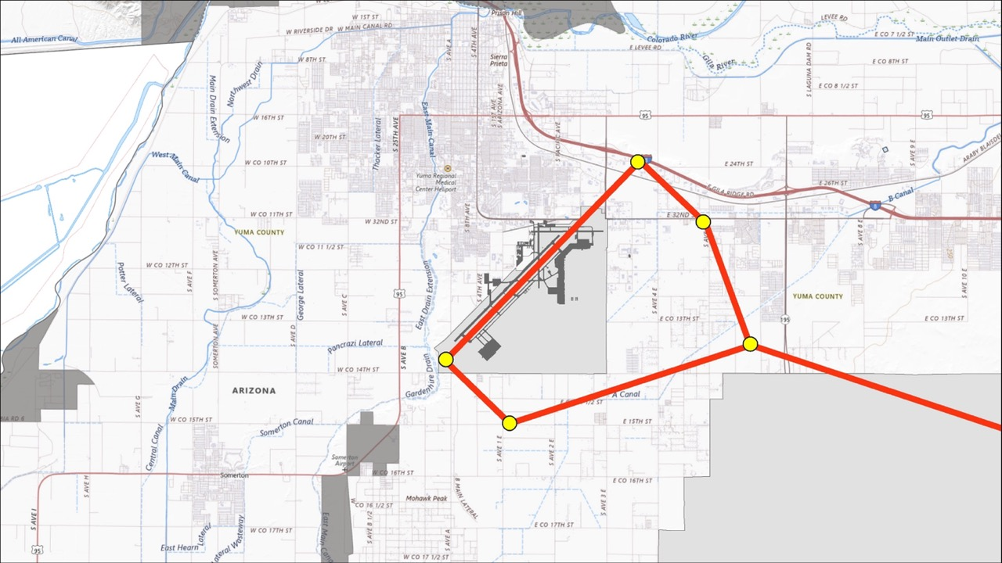
Remotely Piloted Aircraft (RPA)
Future Departure Flight Tracks
Transit to Restricted Airspace above BMGR
MCAS Yuma
Barry M. Goldwater Range

Slide 46
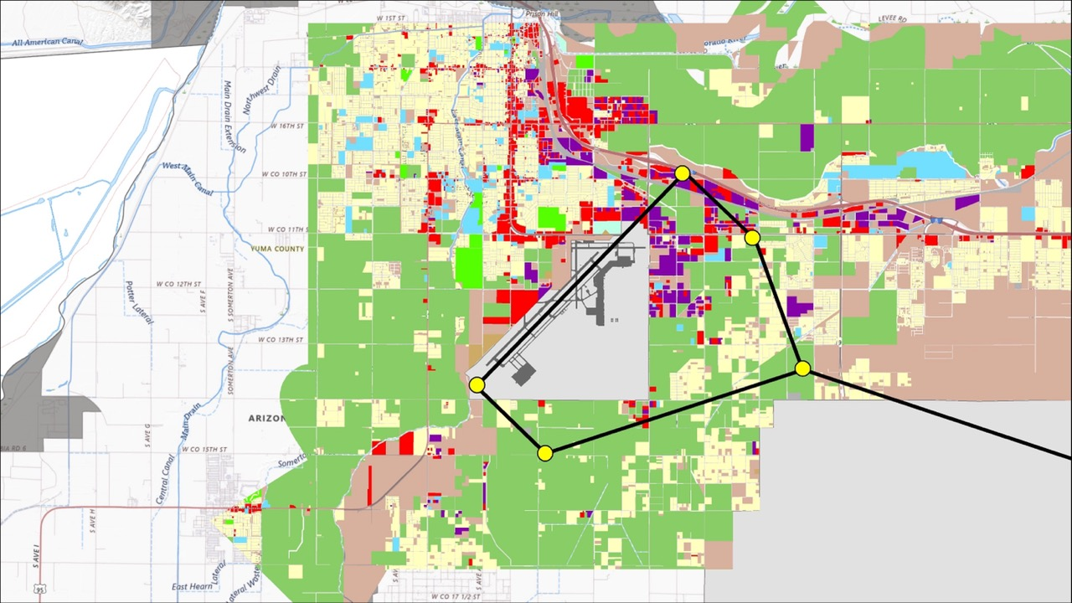
Remotely Piloted Aircraft (RPA)
Future Departure Flight Tracks – Current Land Use
Current Land Use
Agriculture
Residential
Institutional
Commercial
MCAS Yuma
Industrial
Undeveloped
Barry M. Goldwater Range

Slide 47
Airfield imaginary surfaces
Military airfield imaginary surfaces are applied to all runways at MCAS Yuma under federal regulations (14 CFR Part 77).
The elevations of the various surfaces are used to determine if a structure, such as a wireless tower, is too tall and could be a hazard to aviation.
Tall structures within these areas are evaluated by the FAA, which issues a hazard determination in consultation with the covered airport.

Slide 48
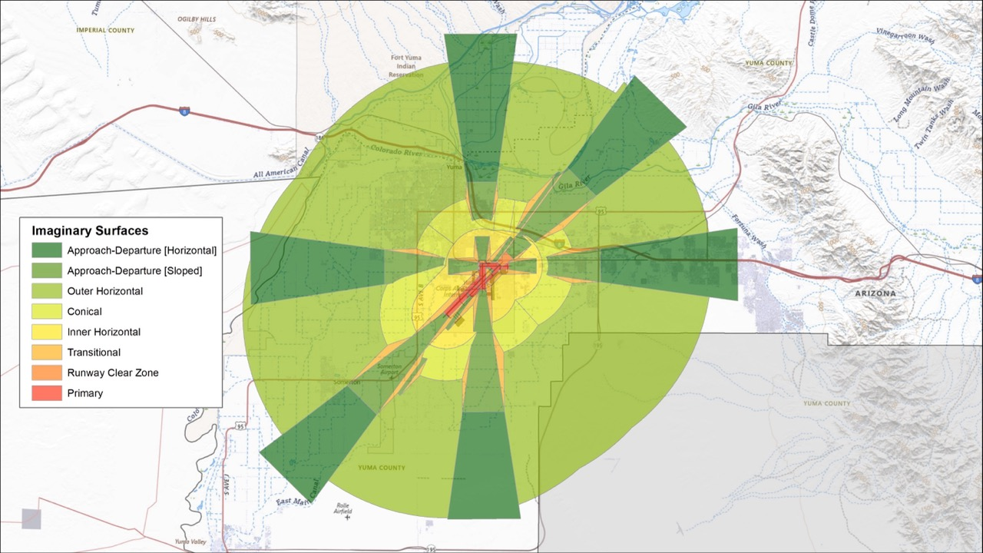
MCAS Yuma Imaginary Surfaces
Barry M. Goldwater Range

Slide 49
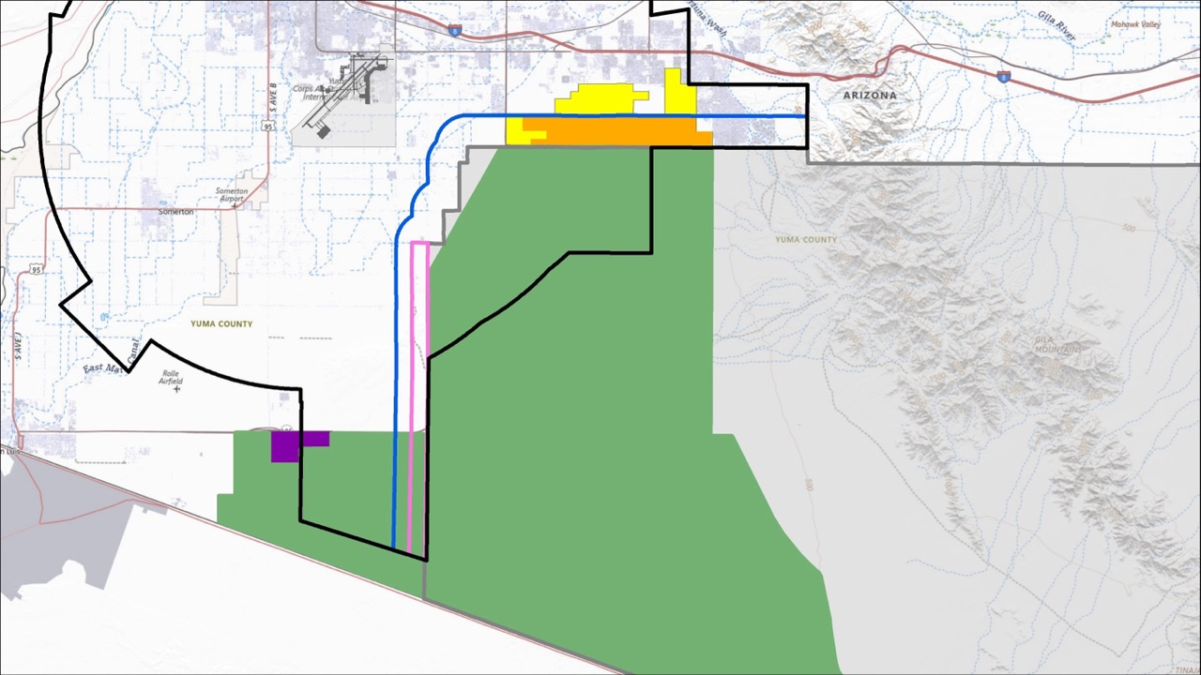
Flat Tail Horned Lizard Priority Habitat
Additional Habitat
MCAS Yuma
Study Area
1 Mile Buffer
Priority Habitat
½ Mile Buffer
Barry M. Goldwater Range
FTHL Management Area
City of Yuma Habitat Property

Slide 50
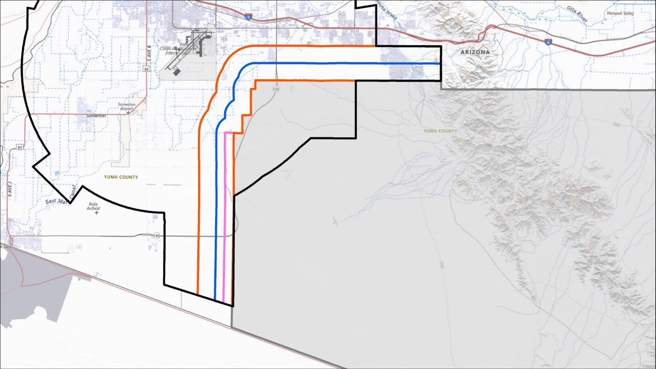
HB 2548 2-Mile “Influence Area”
MCAS Yuma
Study Area
BMGR Influence Area
Barry M. Goldwater Range
1 Mile Buffer
½ Mile Buffer

Slide 51
Determining allowable uses
Step 1
What is my “Base Zoning” Designation?
Step 3
What “Airport Overlay” Zones apply?
Step 2
What uses are allowed under “Base Zoning?”
Step 4
What uses are allowed under existing “Airport Overlays?”

Slide 52
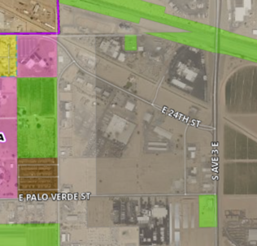
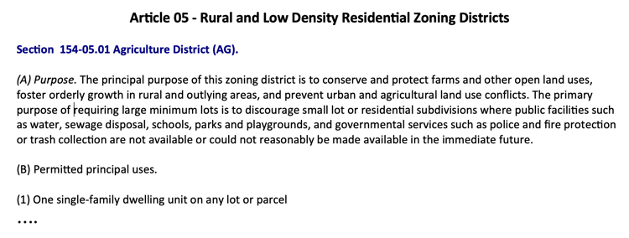
Determining allowable uses
Step 1
What is my “Base Zoning” Designation?
Step 3
What “Airport Overlay” Zones apply?
Base Zoning - AG
Step 2
What uses are allowed under “Base Zoning?”
Step 4
What uses are allowed under existing “Airport Overlays?”
Yuma Zoning Map

Slide 53
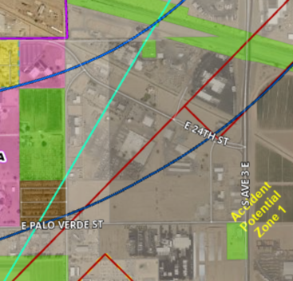
Determining allowable uses
Step 1
What is my “Base Zoning” Designation?
Airport Overlay District – APZ-1
AOD – NZ 75 dB
Step 3
What “Airport Overlay” Zones apply?
75-80 dB Noise Contour
Step 2
What uses are allowed under “Base Zoning?”
Step 4
What uses are allowed under existing “Airport Overlays?”
Yuma Zoning Code, Section 154-14.05

Slide 54
Housing assessment overview

Slide 55
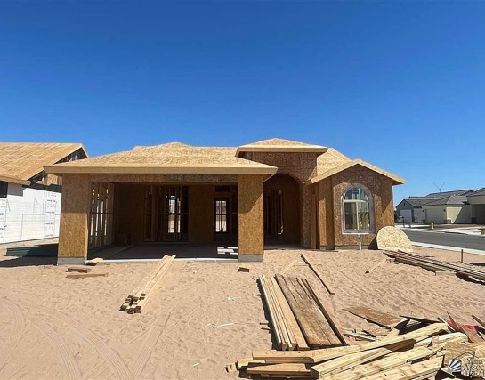
Housing assessment
Scope of Work Includes 7 Tasks:
Baseline Analysis
Land Supply Analysis
Key Informant Interviews
Housing Needs Estimate
Capacity / Gap Analysis
Recommendations
Final Report

Slide 56
Community impacts and observations

Slide 57
Fact-Finding Exercise – Aug 22
Agency Participants: 20+ attendees including elected officials, decision-makers, and senior staff
Identified stakeholder goals and interests, authorities, and limitations related to four key issues.
Documented unique stakeholder perspectives and level of agreement on issues.

Slide 58
Exercise Attendees
City of Yuma: Doug Nicholls, Mayor Chriss Morris, Councilmember Richard Files, City Attorney Jennifer Albers, Asst. Dir. of Planning
Yuma County: Lynne Pancrazi, Board Member Josh Scott, Deputy County Administrator Craig Sellers, Planning Director
City of Somerton: Miguel Villalpando, Councilmember Lizandro Galaviz, City Manager Saul Albor, Dir. of Community Development
MCAS Yuma / BMGR-W: Col Stone, Commanding Officer
Lt Col Trevor Tingle, Executive Officer Greg McShane, Airspace Manager Randy English, Natural Resources Manager
SMEs: Alyssa Linville, Bill Sellars, Mary Ellen Finch, Pat Barber, Crystal Figueroa
Table Facilitators: Tyson Smith, Vagn Hansen, Jason Winner, Caitlin Cameron

Slide 59
Top takeaways
Stakeholders worked constructively together to explore a common understanding of facts and issues.
Clear expression of common interest to work together to support future growth both on- and off-base.
Discussion of individual perspectives and alignment across stakeholders provided valuable information that will inform next steps.
Agreement that compromises will be needed and can be explored in the JLUP process.

Slide 60
Key Issues
Urban Growth Limits and Demands:
Overlay districts, buffers, governmental land ownership, and physiographic features all combine to significant limit the amount of developable land.
It is a major community concern that long-term growth demands exceed land availability based on current trends.
Military Compatibility Needs:
Military seeks to grow mission; future operations may look different, and it is important to create policies that will allow flexibility.
Better understanding is desired for number of civilian vs military operations; and also for difference between FAA and DOD compatibility recommendations.
Community protections need to be negotiated and may not match DOD AICUZ recommendations.

Slide 61
Key Issues
FTHL Habitat
Participation in Rangewide Management Strategy helps reduce risk of USFWS or state listing; Important issue for installation, who manages habitat on BMGR-W.
If FTHL is listed, it can create regulatory impacts throughout the historic footprint, which includes significant community areas outside of the installation.
Stakeholder consensus to find ways to protect habitat and prevent listing.
Transportation Planning on County Rd. 14
More information is needed on State Lands desire for alternative to the approved alignment of County Road 14 identified in the MPO Long-Range Transportation Plan (LRTP).
LRTP update and “Routes of Regional Significance Study” coming soon; both will have many stakeholder input opportunities to explore this issue.

Slide 62
Next steps
Develop After-Action Report to document facts, issues, and perspectives. Report will become part of JLUP document.
Engage with Working Group and Steering Committee to identify needs for further evaluation and recommendations regarding policy options for addressing key issues.

Slide 63
Live Polling Event and community Questionnaire

Slide 64
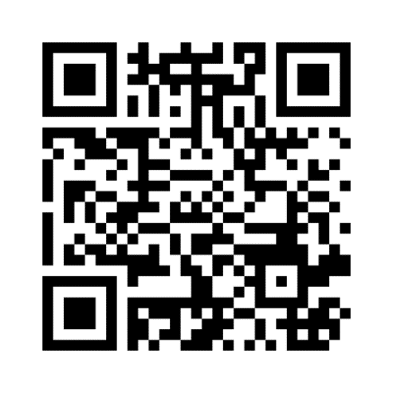
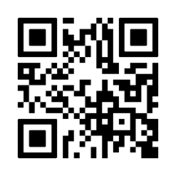
questionnaire FORMAT
Demonstration only: Live polling exercise during public workshop on August 22.
Official online questionnaire: available from August 22 - September 12. Users may only submit one response.
Questionnaire also available in print format

Slide 65
questionnaire
Questionnaire was sent to Working Group for input
Questionnaire Goal: Capture stakeholder input on compatibility issues relating to the MCAS Yuma training and community land use planning.
Questions include:
Demographics
Communications
MCAS Yuma operations
Potential compatibility issues

Slide 66
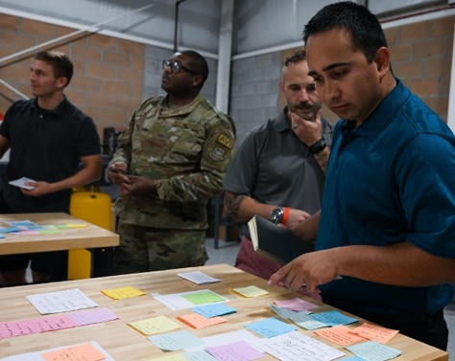
questionnaire FORMAT
Questions will be provided:
As a live polling during the public workshop on August 22.
As an online questionnaire, available until August 22 - September 12.
Questionnaire results:
Will become part of JLUP document
Will inform further analysis and recommendations.

Slide 67
Public outreach plan

Slide 68
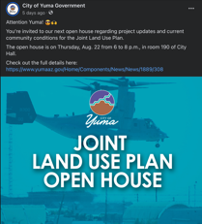
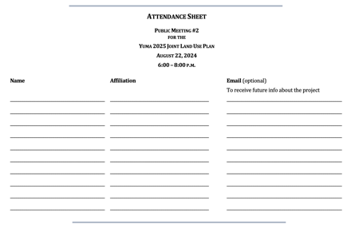
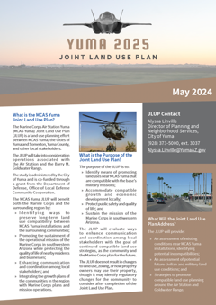
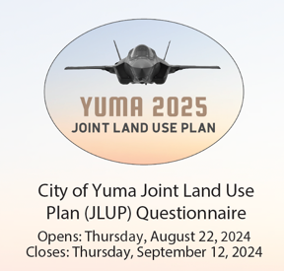
What we’re doing now

Slide 69
Community comment

Slide 70
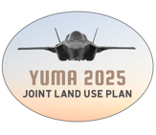
Next STEPS
Public Questionnaire Completed (Sept 12th)
Compatibility Analyses Completed
Questionnaire Results Summarized, Posted, Presented
Housing Assessment Baseline Assessments and Key Informants Interviews
Policy Alternatives Development

